Slide 2
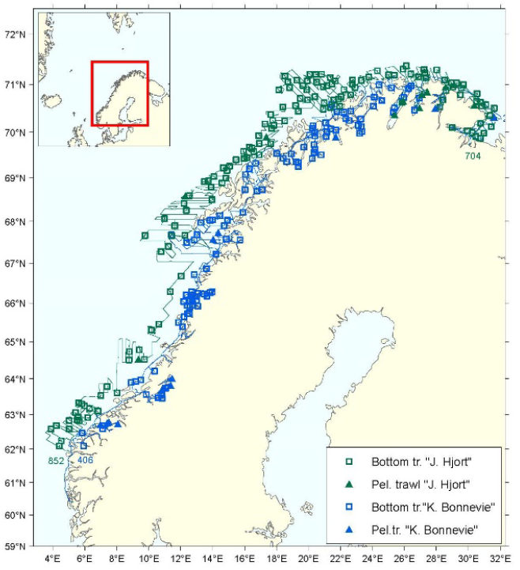
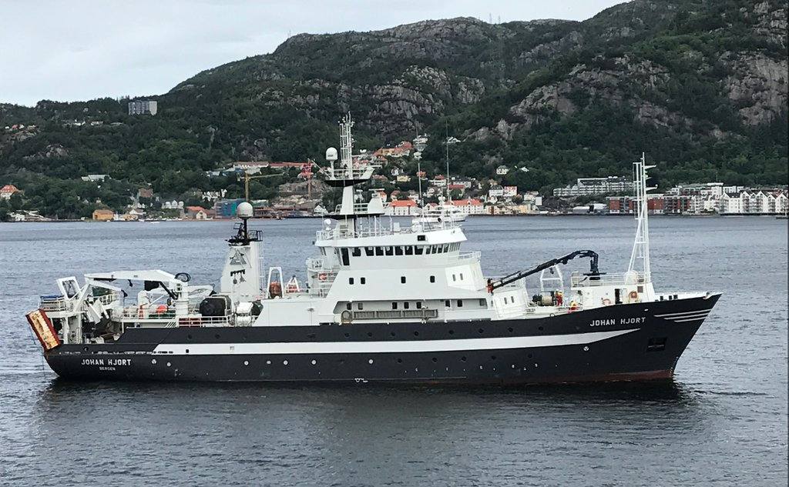

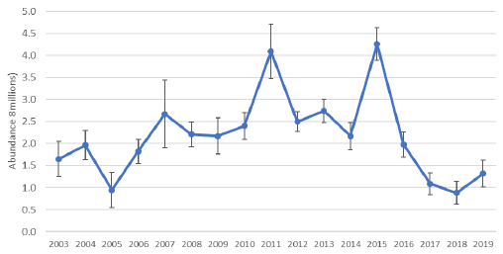
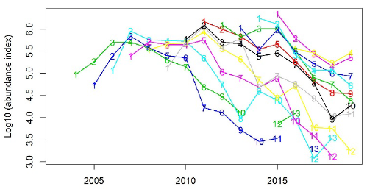

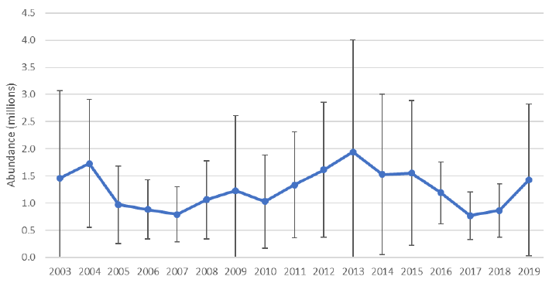
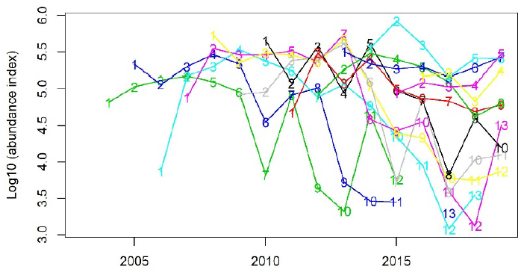

Coastal acoustic-trawl survey
South of 67N:
Lower precision and consistency
“Aggregate (age 2+) acoustic and trawl indices may be used in biomass models”
Aglen et al. 2021. Mengdeindekser for kysttorsk nord for 62°N.
Notes:
“Acoustic and trawl indices of biomass of age 2+ may be used in biomass models or to assess changes in stock abundance from year to year, using methods for data-poor stocks.”

Slide 3
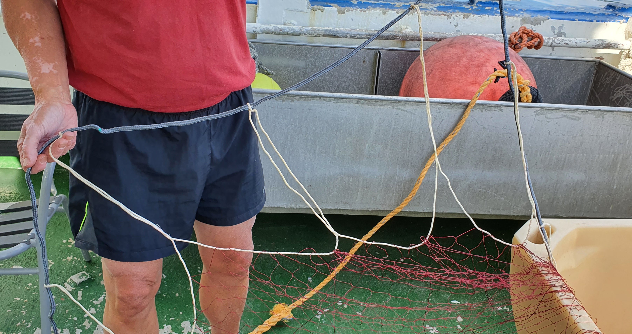
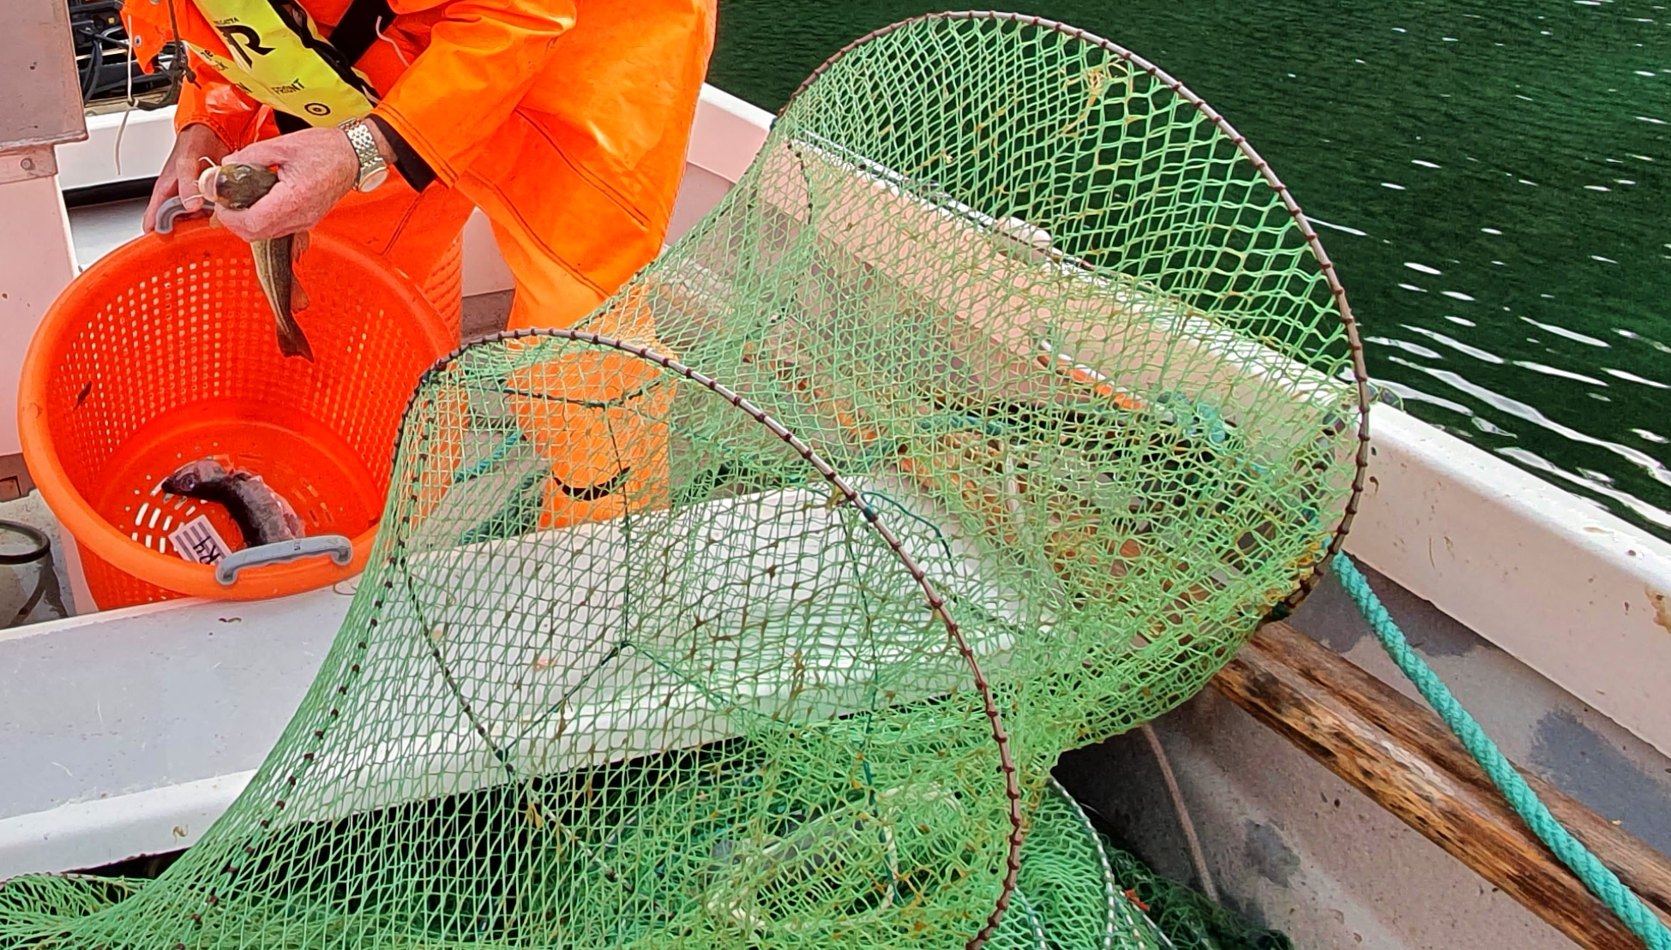
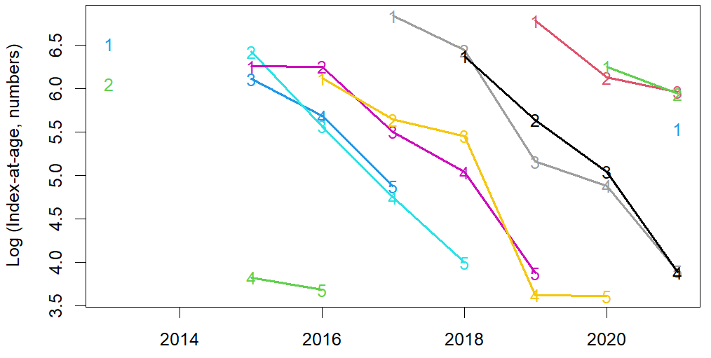
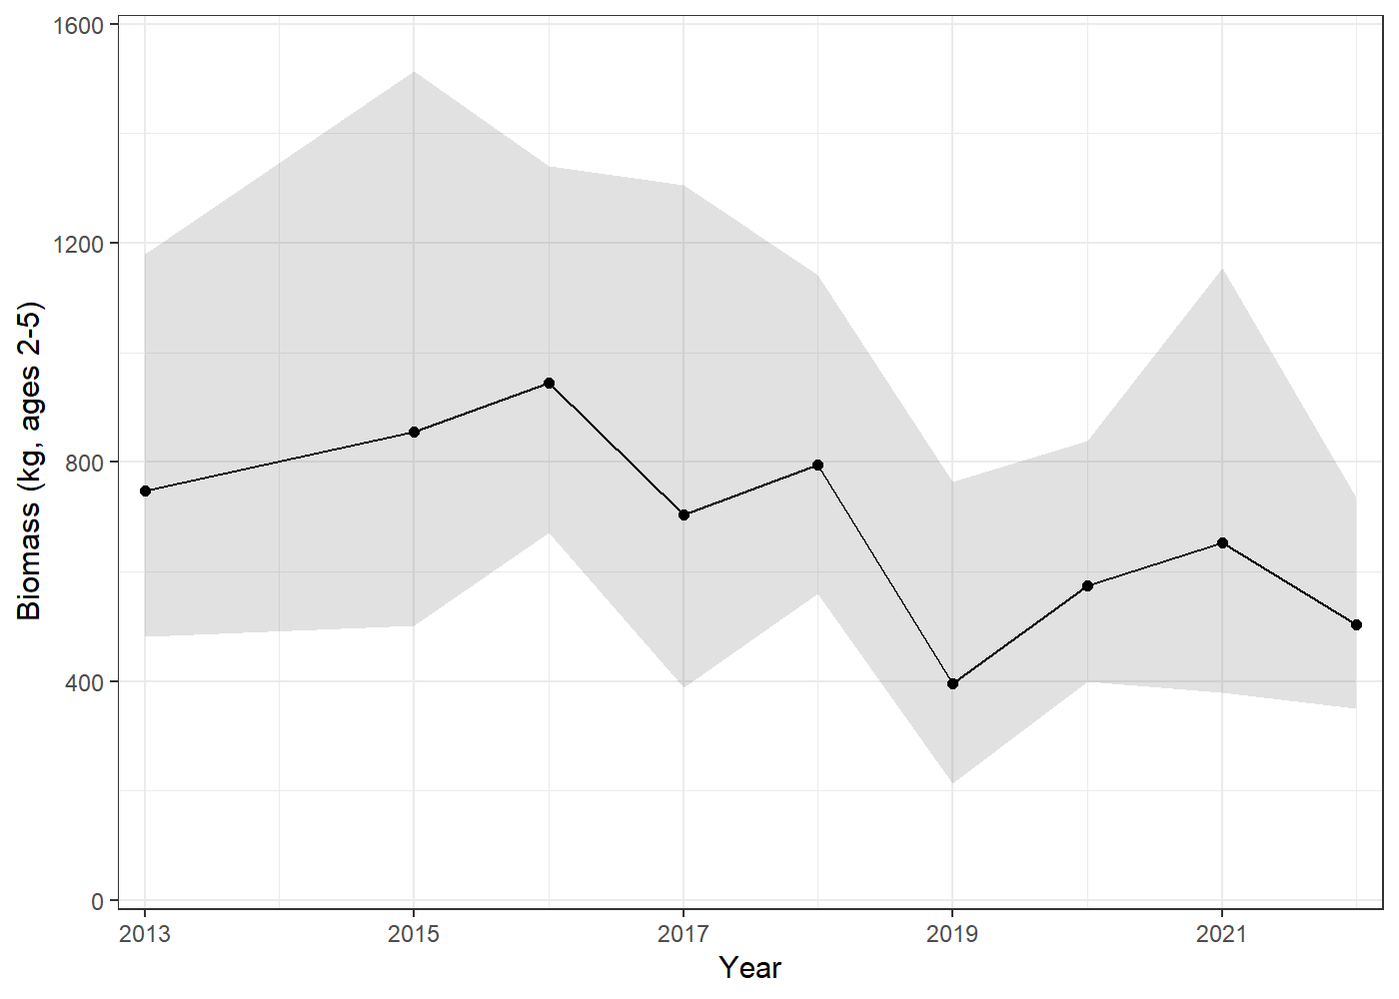
Shallow net survey
One ‘site’ =
6 ruse + 2 garn_{45mm} + 2 garn_{36mm}
Garn / trammel
10-25 m
36 mm
45 mm
Ruse / fyke
2-10 m
Eidset 2019
Catches ages 0-5
Tracks cohorts
Spatiotemporal GLM to produce aggregate biomass

Slide 4
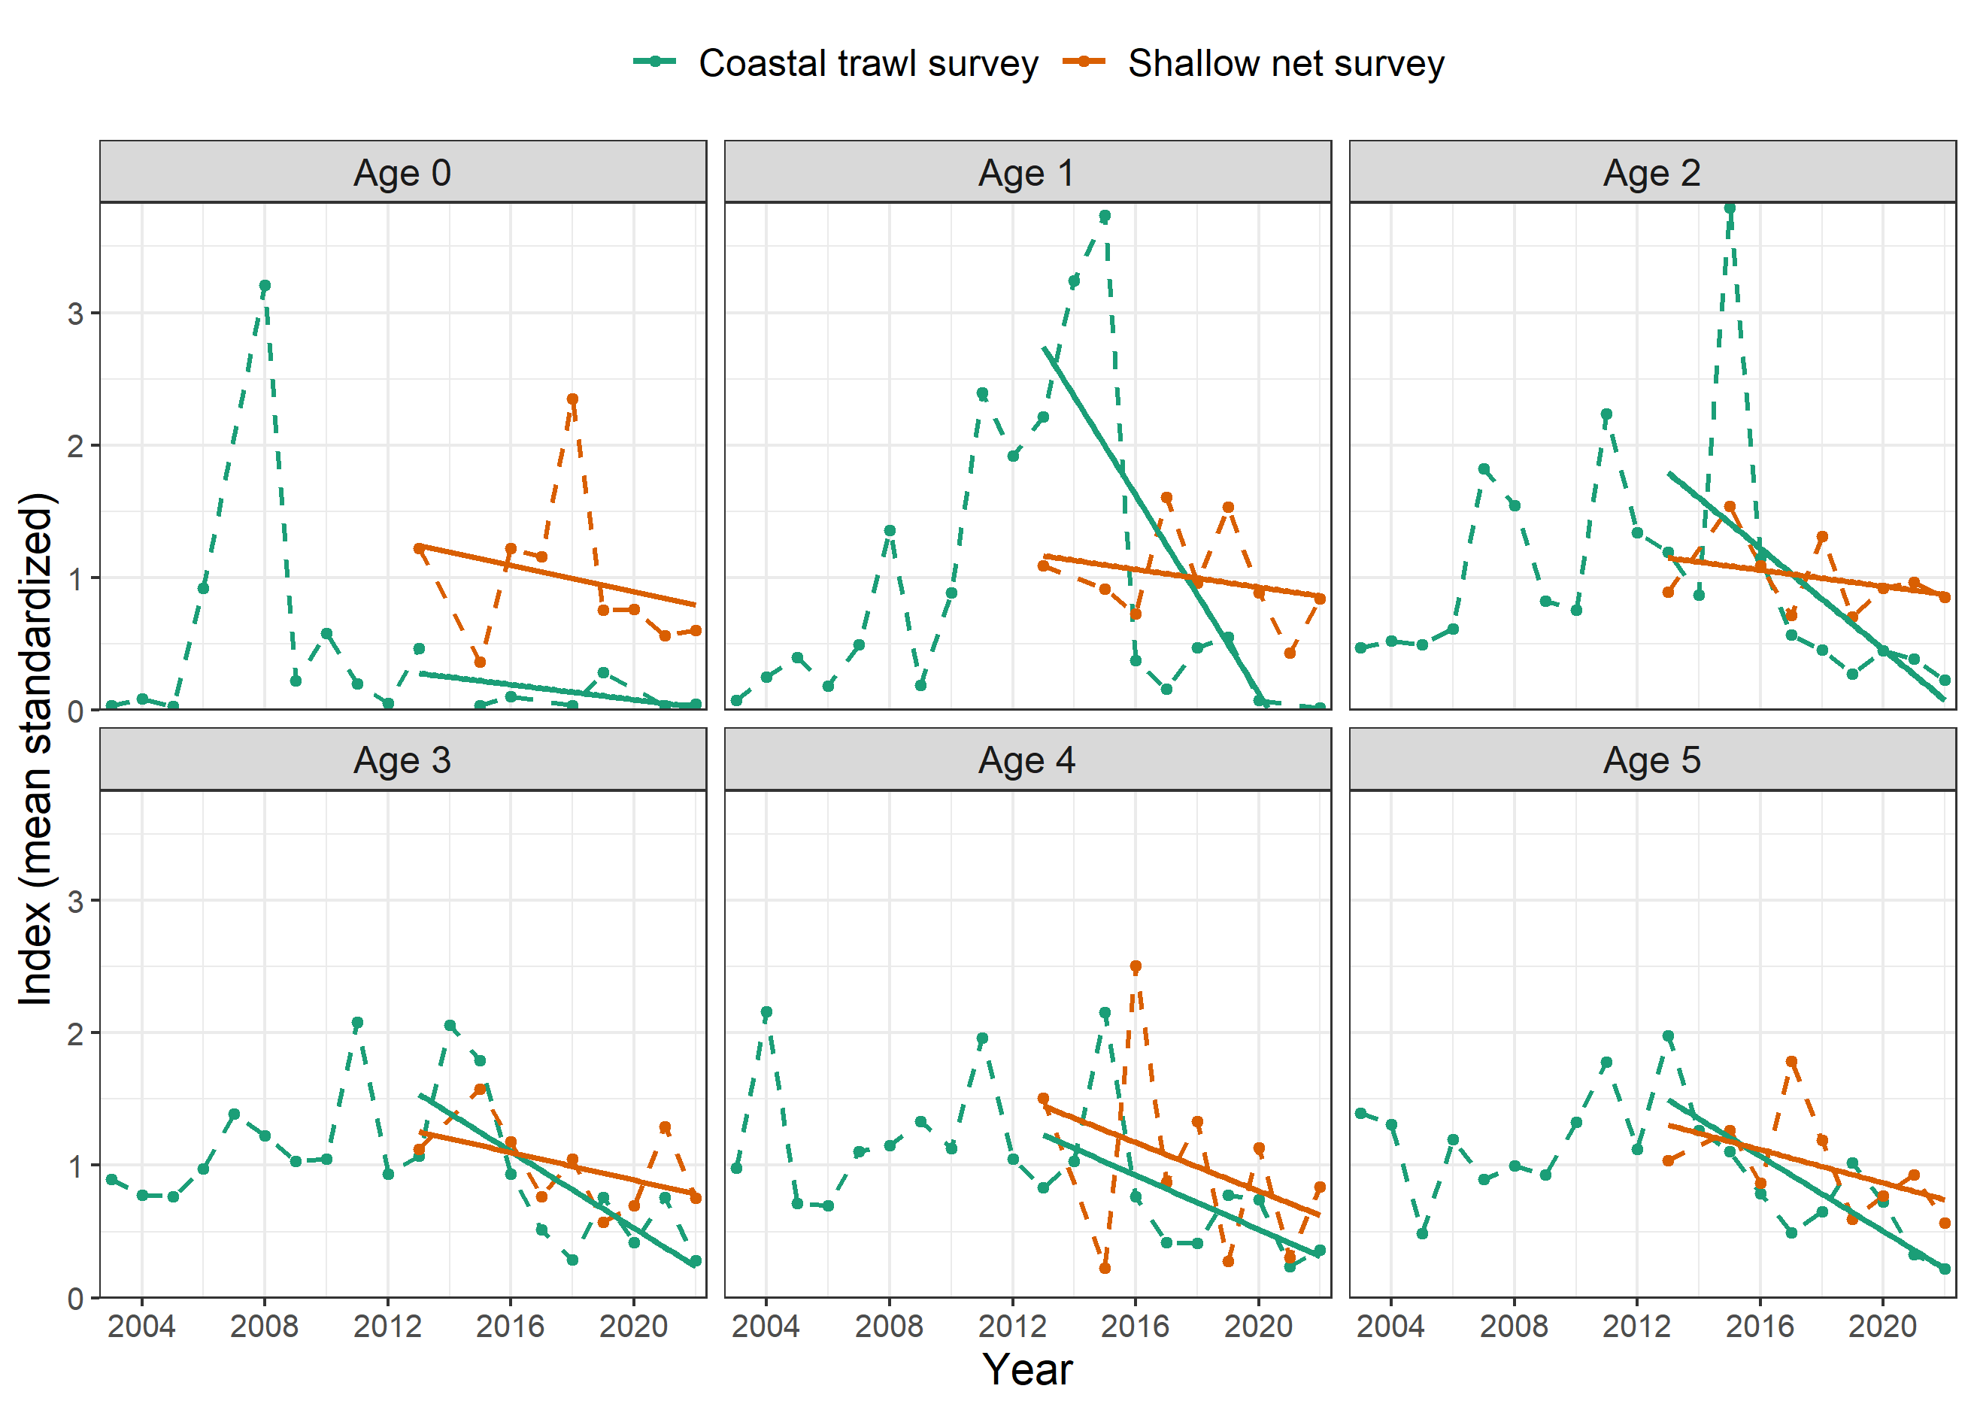
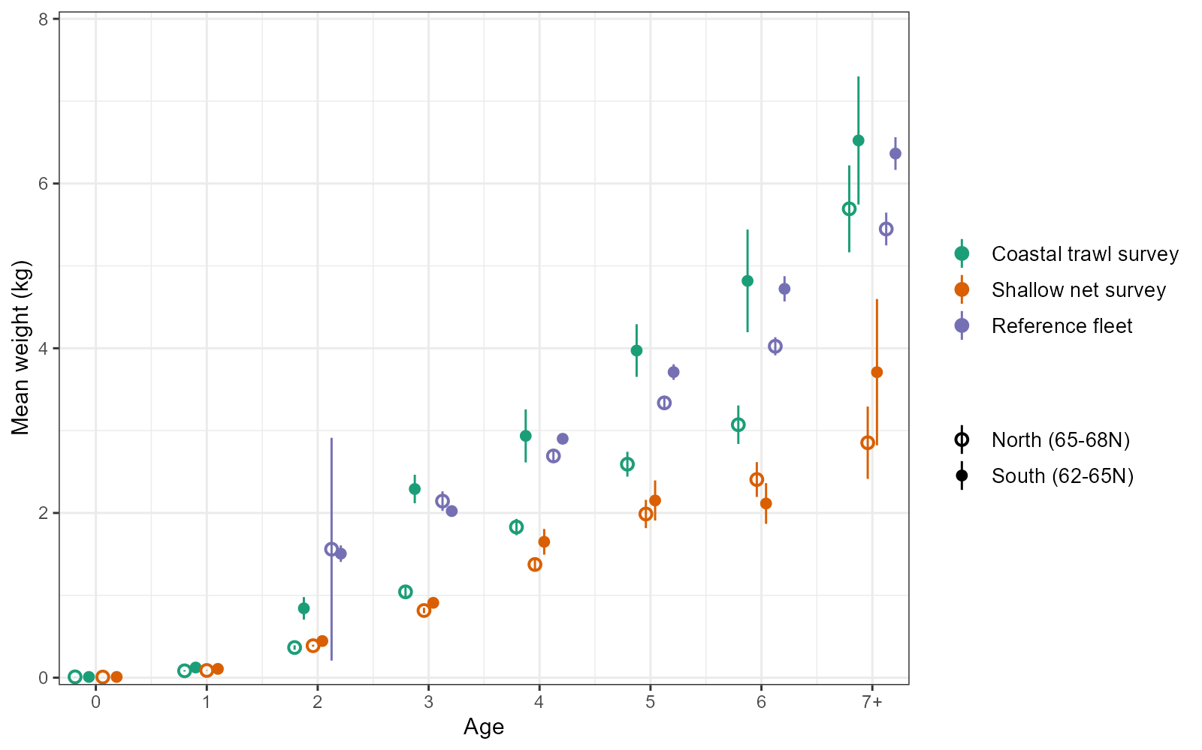
Trawl and shallow net surveys
Consistent trends at all ages 0-5
… but are we surveying the same fish?

Slide 5
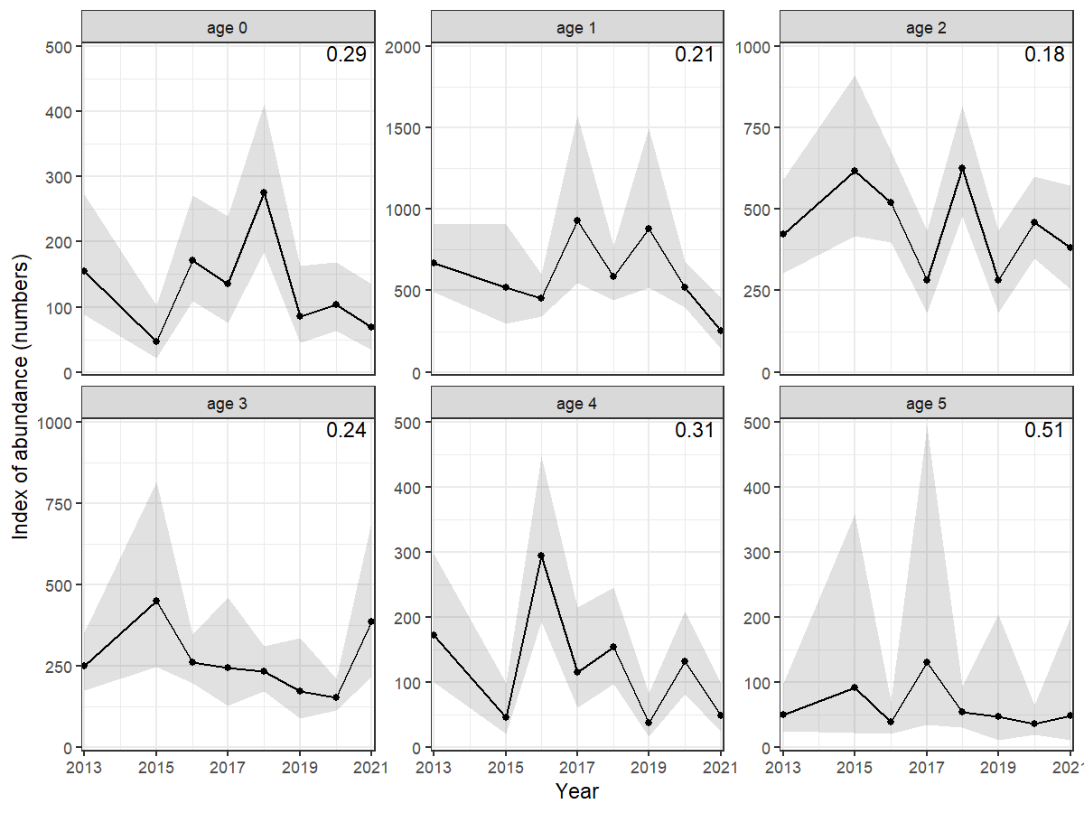
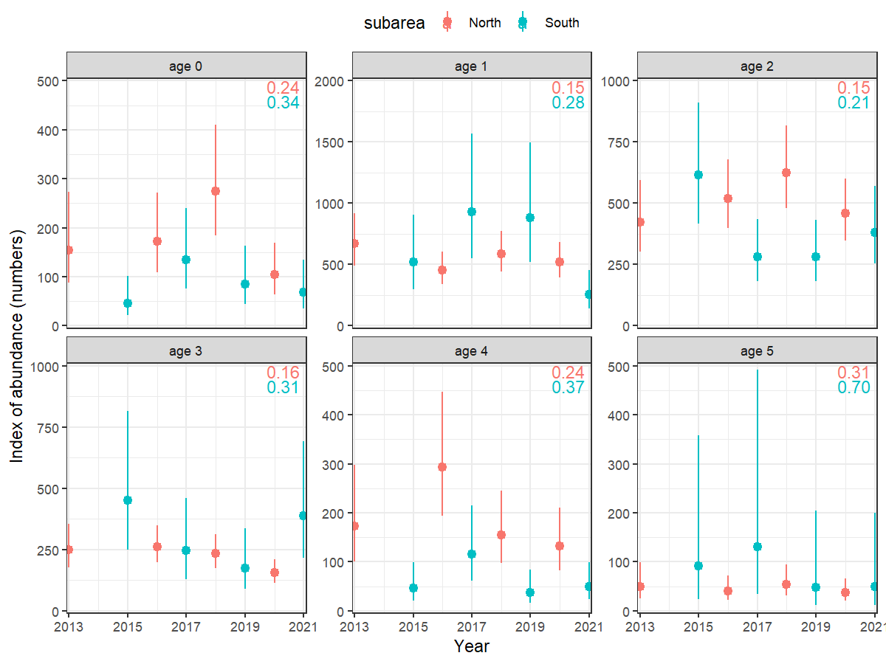
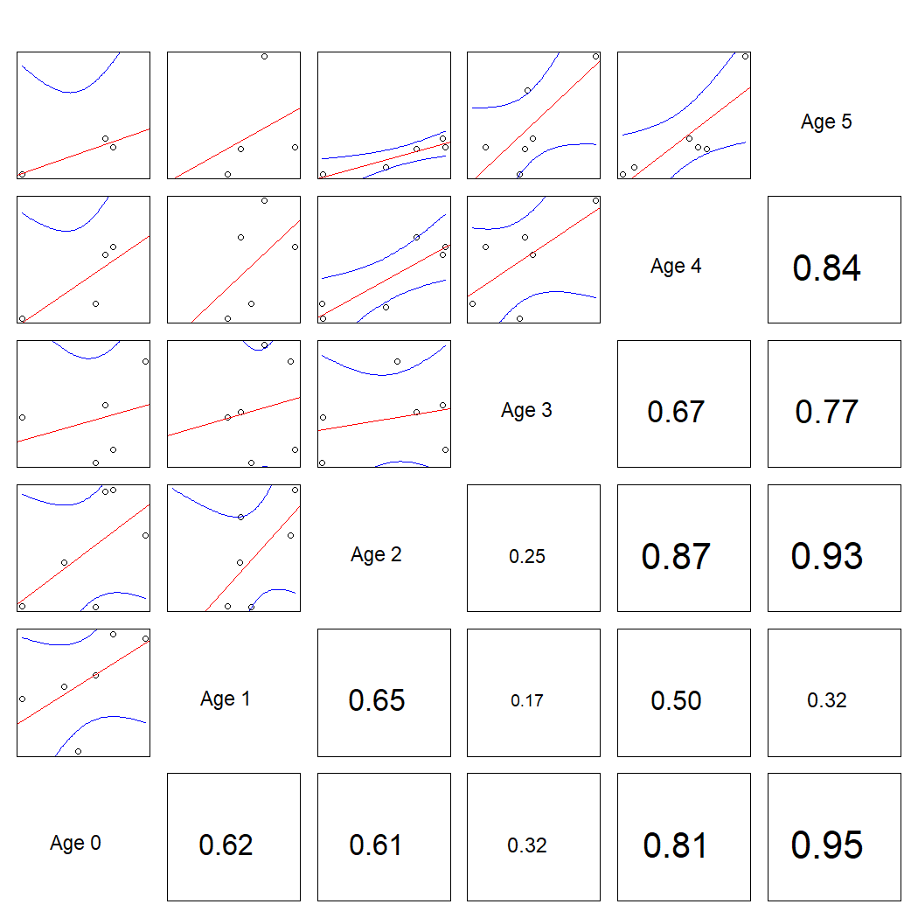
Shallow net survey
y ~ 0 + year + subarea + depth + Hbott + s(lat,lon)
Pretty good CV
ages 1-3: 0.2
0.15 N, 0.25 S
ages 0+4: 0.3
0.24 N, 0.35 S
Good cohort tracking

Slide 6
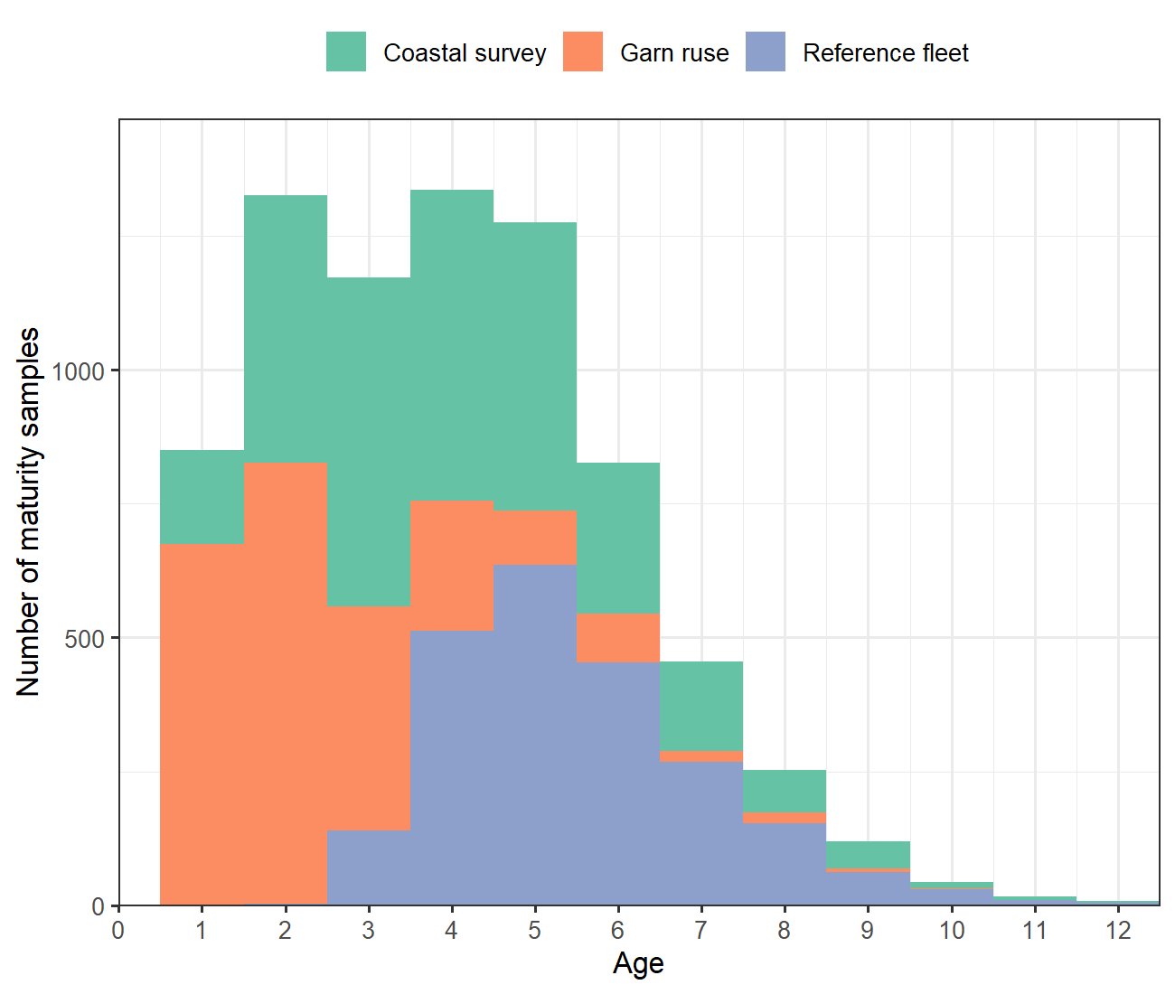
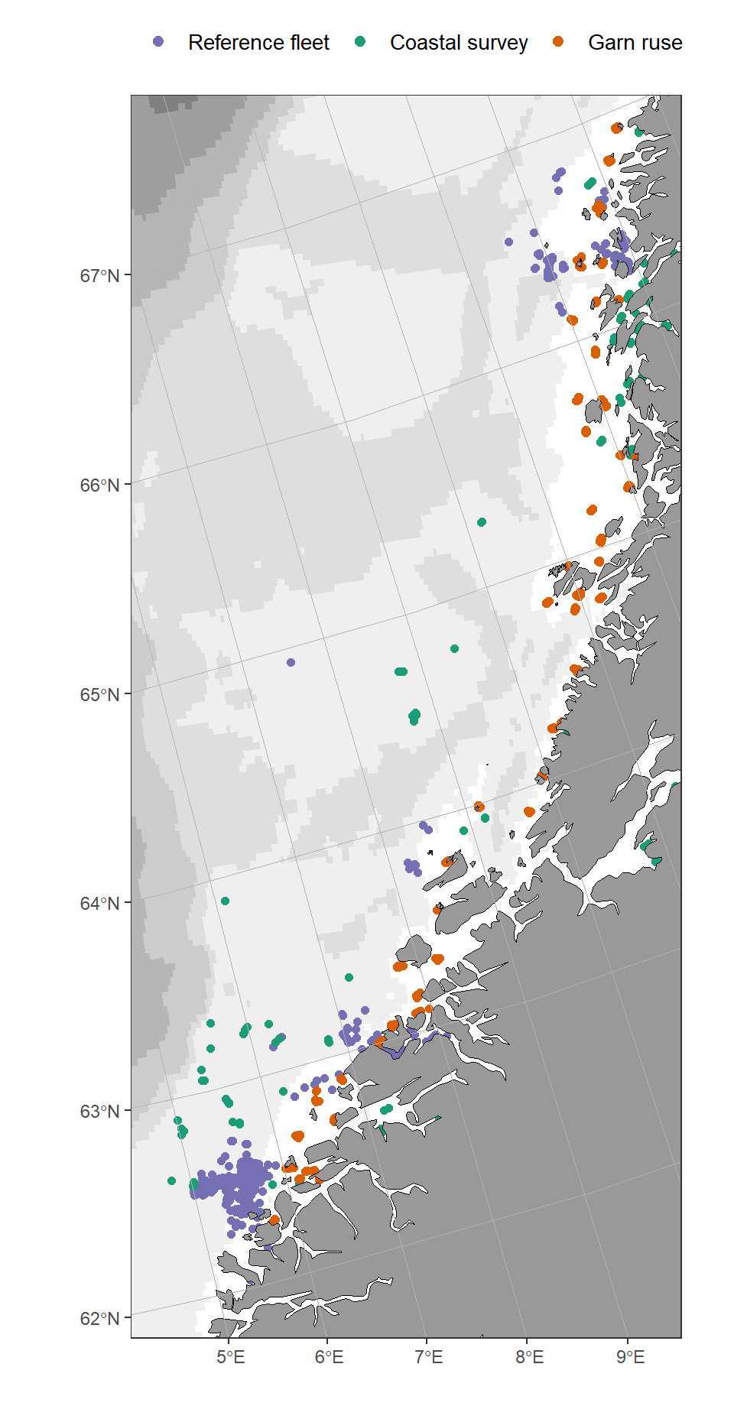
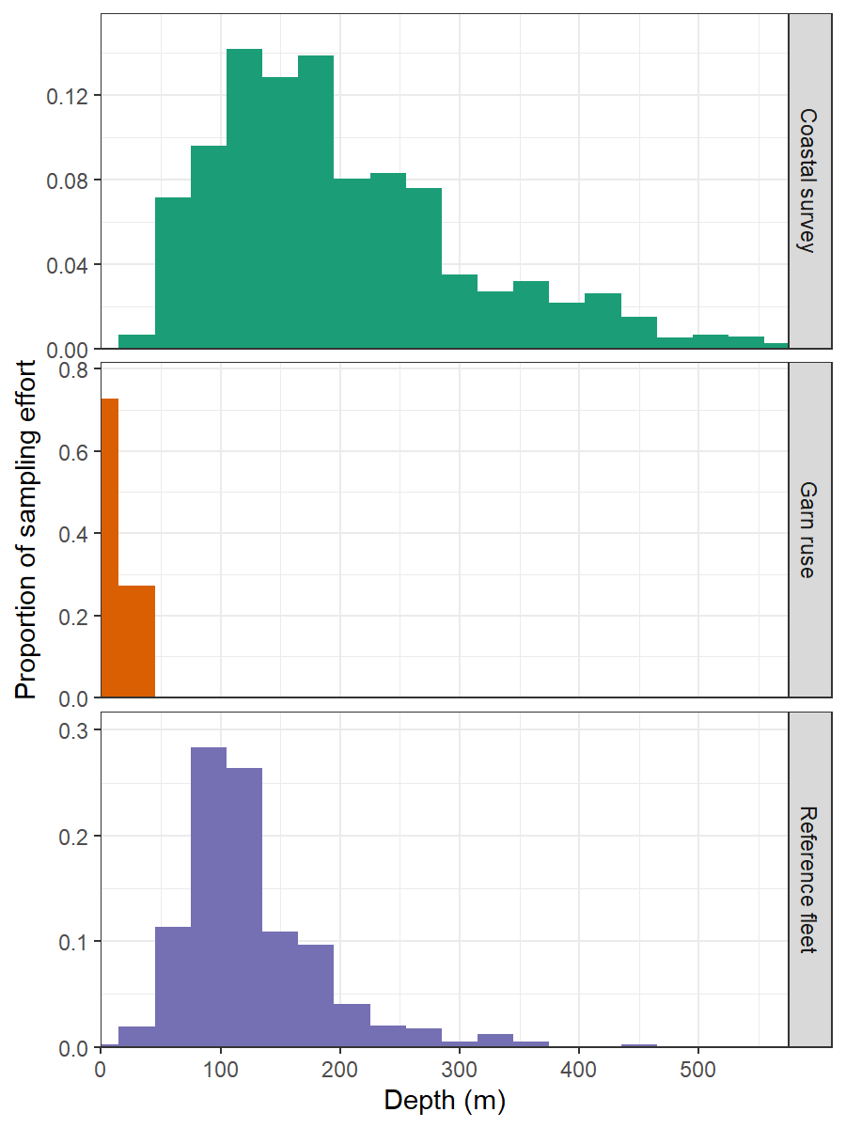
Survey comparison
Much shallower than other surveys (< 25 m)

Slide 7
